Slide 1
Photo studio app
< /
>
Silver Humblers

Slide 2
Team members
Ulvi Bashirov
Fidan Hasanguliyeva
Nihad Abbasov

Slide 3
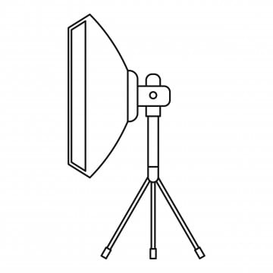

APP LOGIC STRUCTURE
Studio 1
Photo Studio App
ex: Studio 2
Studio 2
…
Our app presents the best studio that suits you
Studio 3
Notes:
<a href="https://www.freepik.com/free-photos-vectors/mockup">Mockup vector created by freepik - www.freepik.com</a>

Slide 4

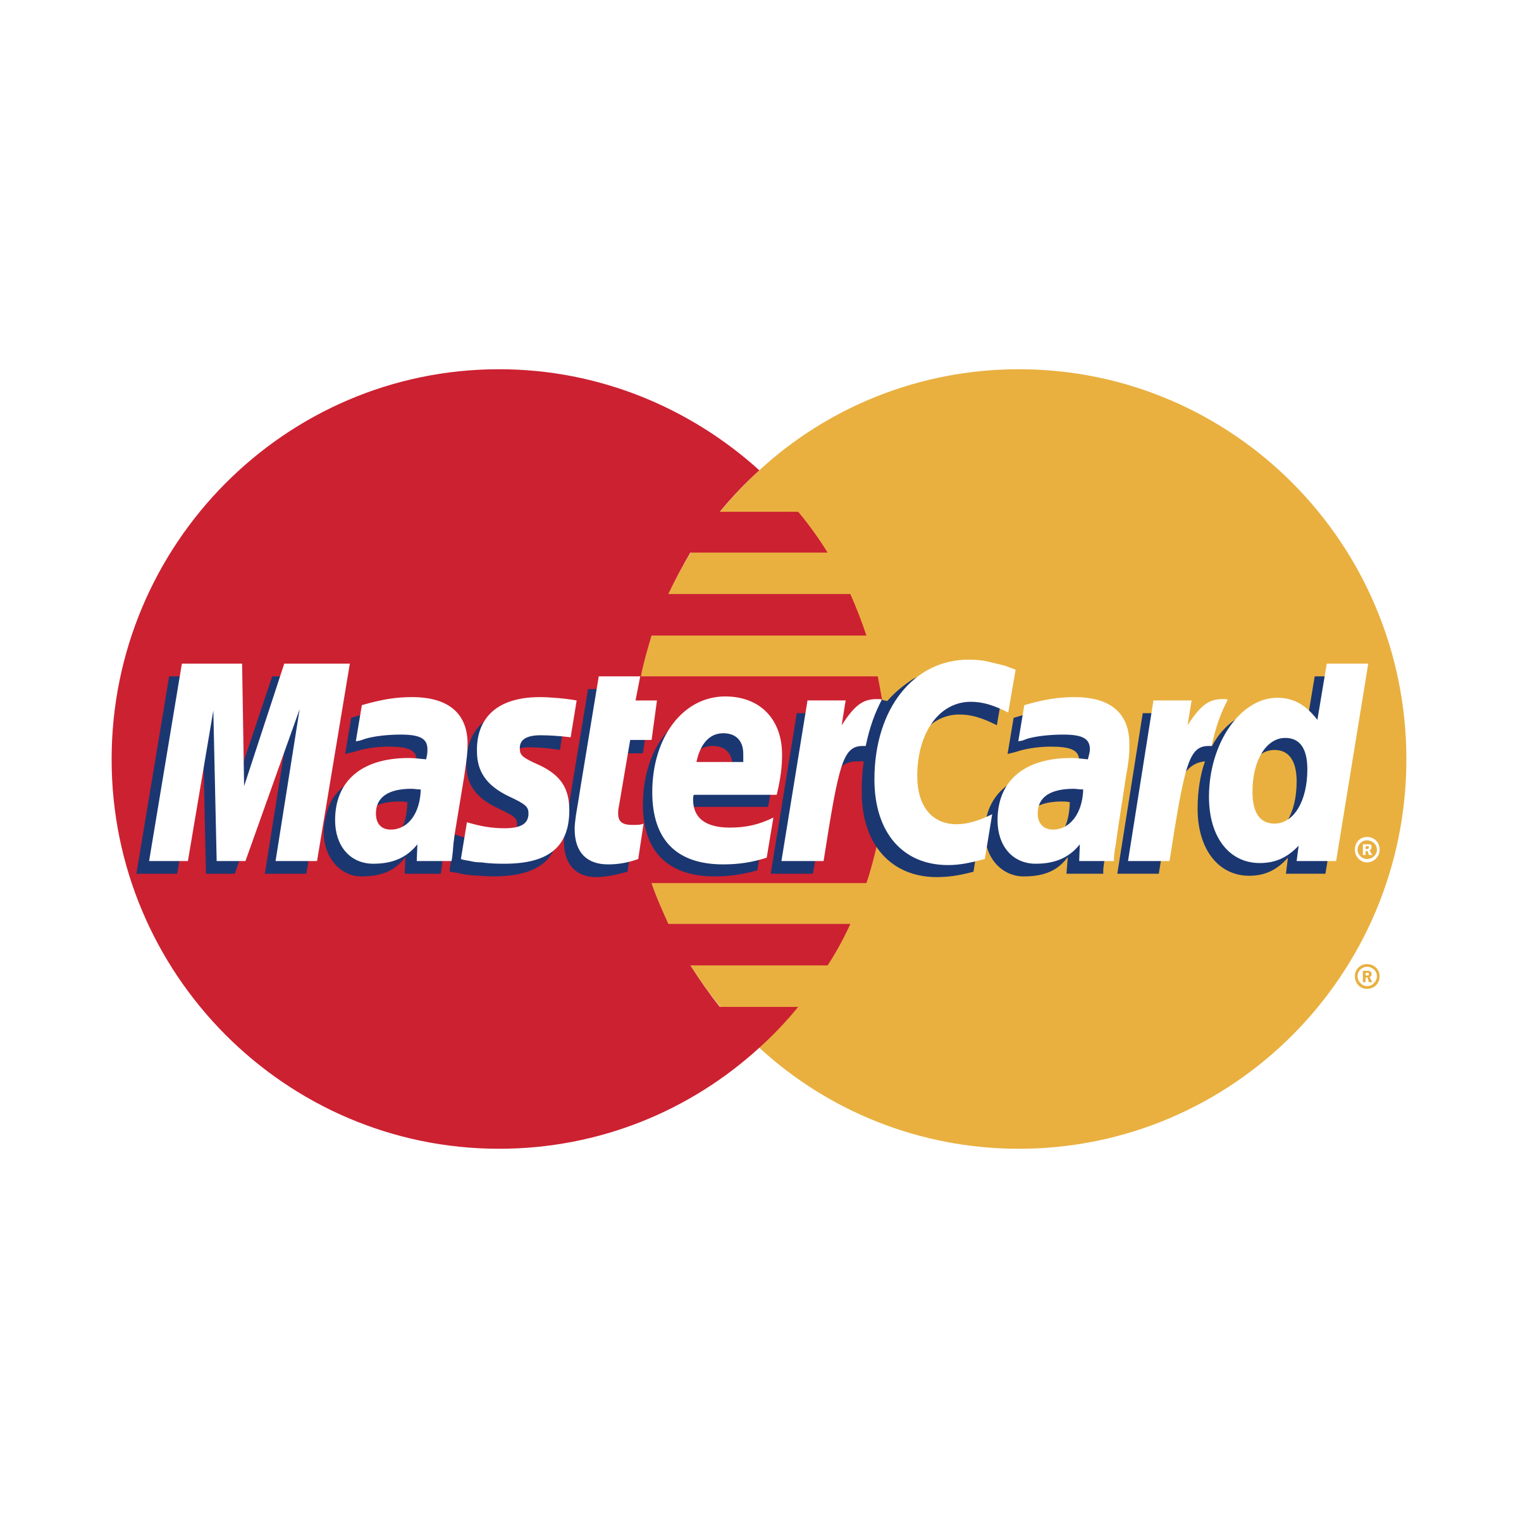


Functionality
Easy to manage bookings.
Simple & Secured payments (Visa, Mastercard, PayPal).
Our support is ready 24/7.
Everybody can register his own studio to this app.
Notes:
<a href="https://www.freepik.com/free-photos-vectors/mockup">Mockup vector created by freepik - www.freepik.com</a>

Slide 5
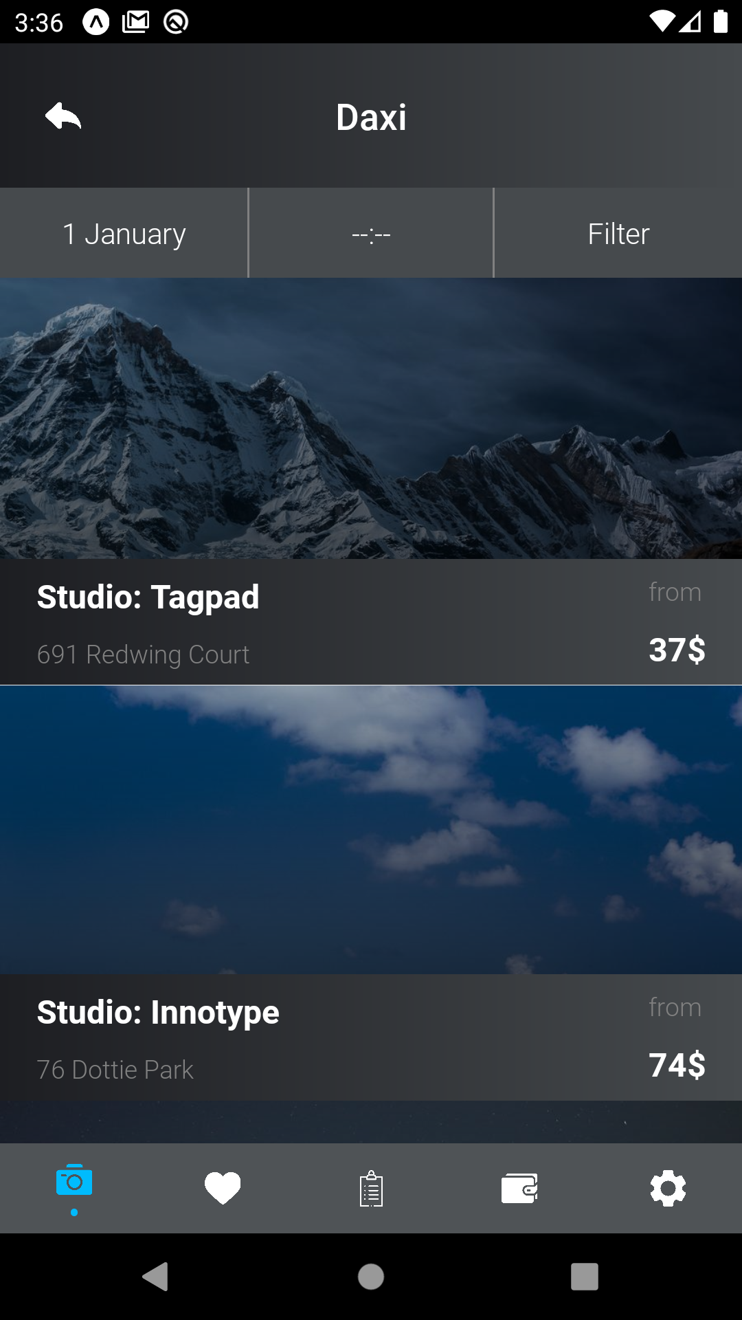
Idea explanation of app
Main idea of app is to make easier to search and find different photo studios in cities. In search screen we can select date, how many hours we need, city, and based on this data filter studios, selecting one of them. User also can create account, save his credit cards in his wallet, and pays to book studio. Also he adds studios he liked to favorites section, later he books them.
Notes:
<a href="https://www.freepik.com/free-photos-vectors/mockup">Mockup vector created by freepik - www.freepik.com</a>

Slide 6



Technology stack
React Native
Redux
Firebase
Notes:
<a href="https://www.freepik.com/free-photos-vectors/mockup">Mockup vector created by freepik - www.freepik.com</a>

Slide 7
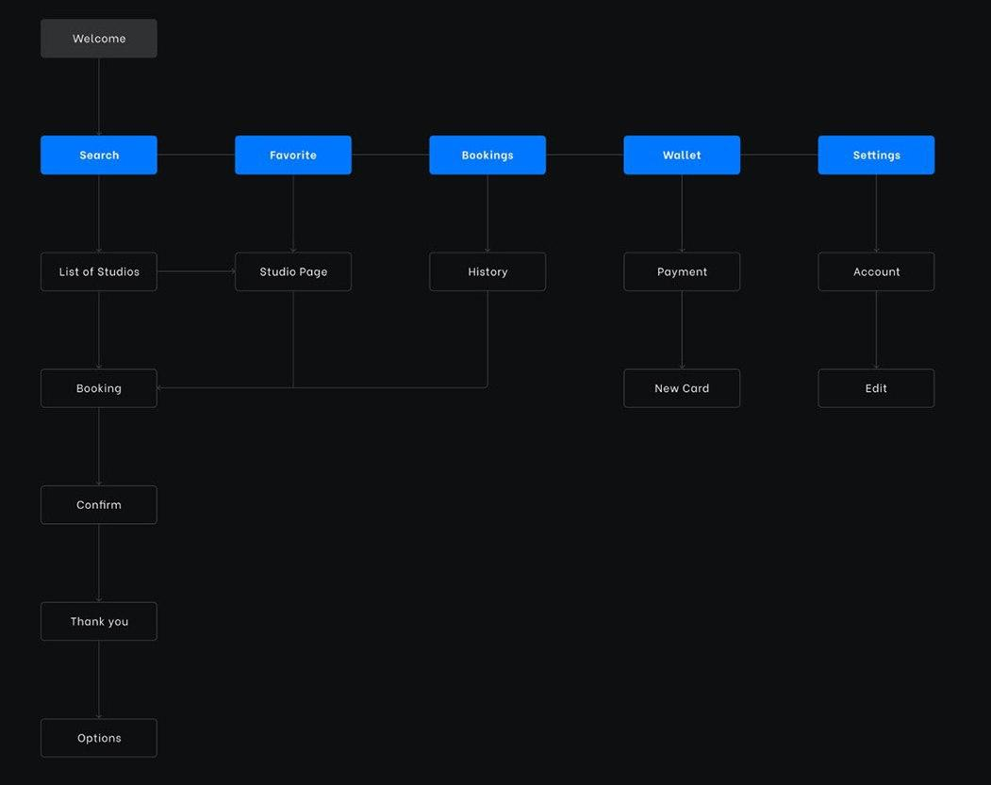

Slide 8
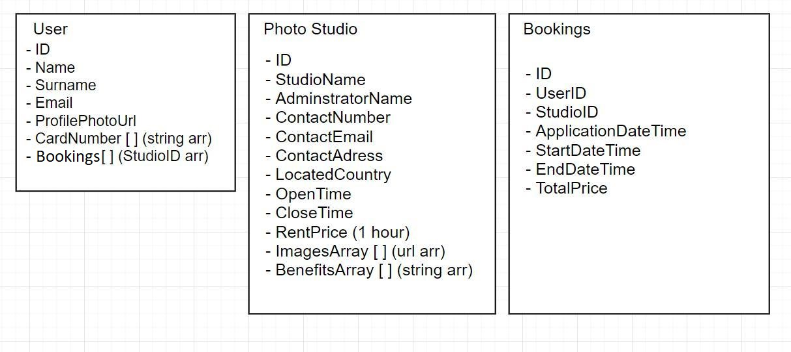

Slide 9
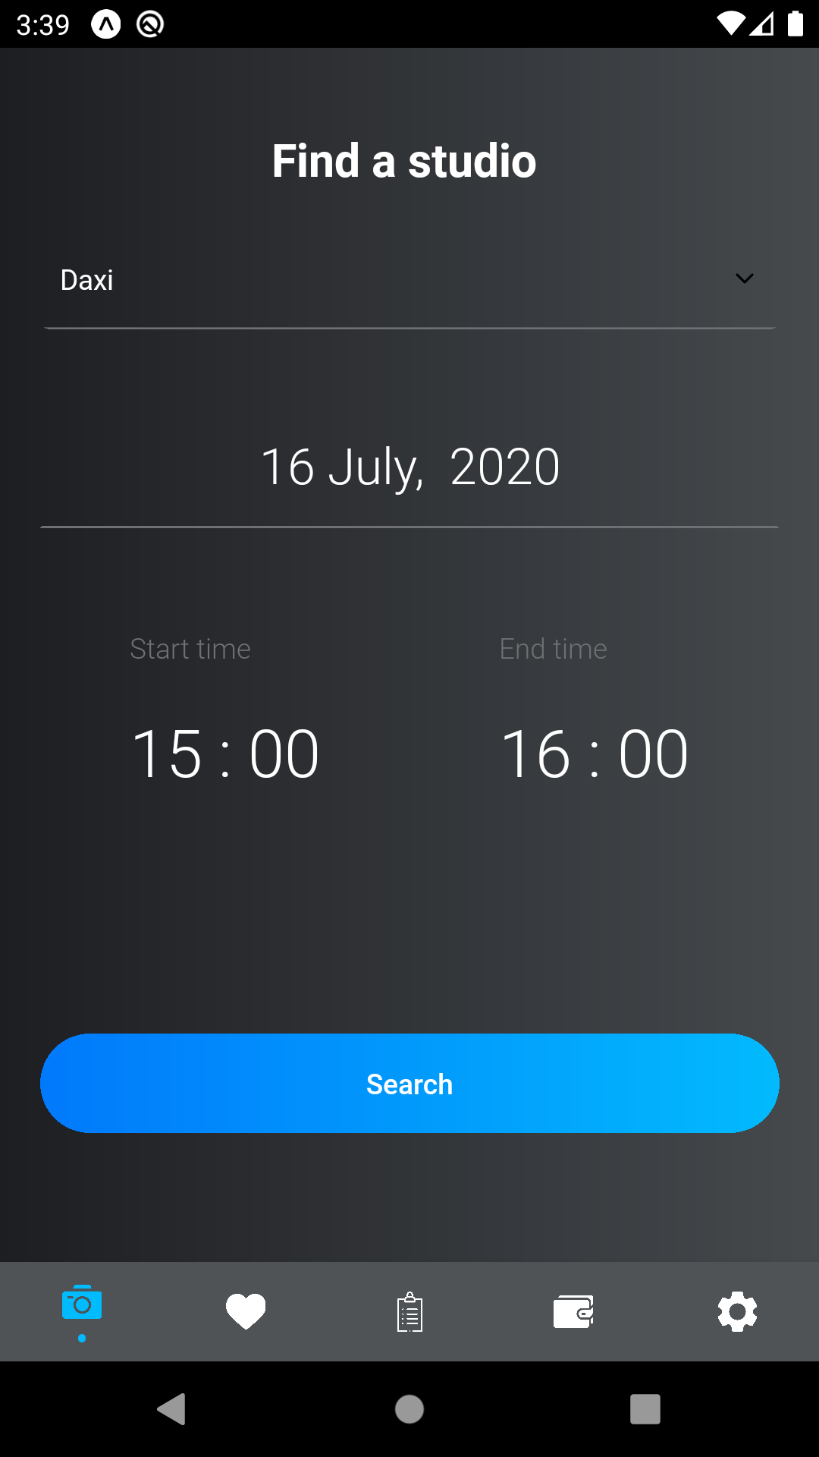
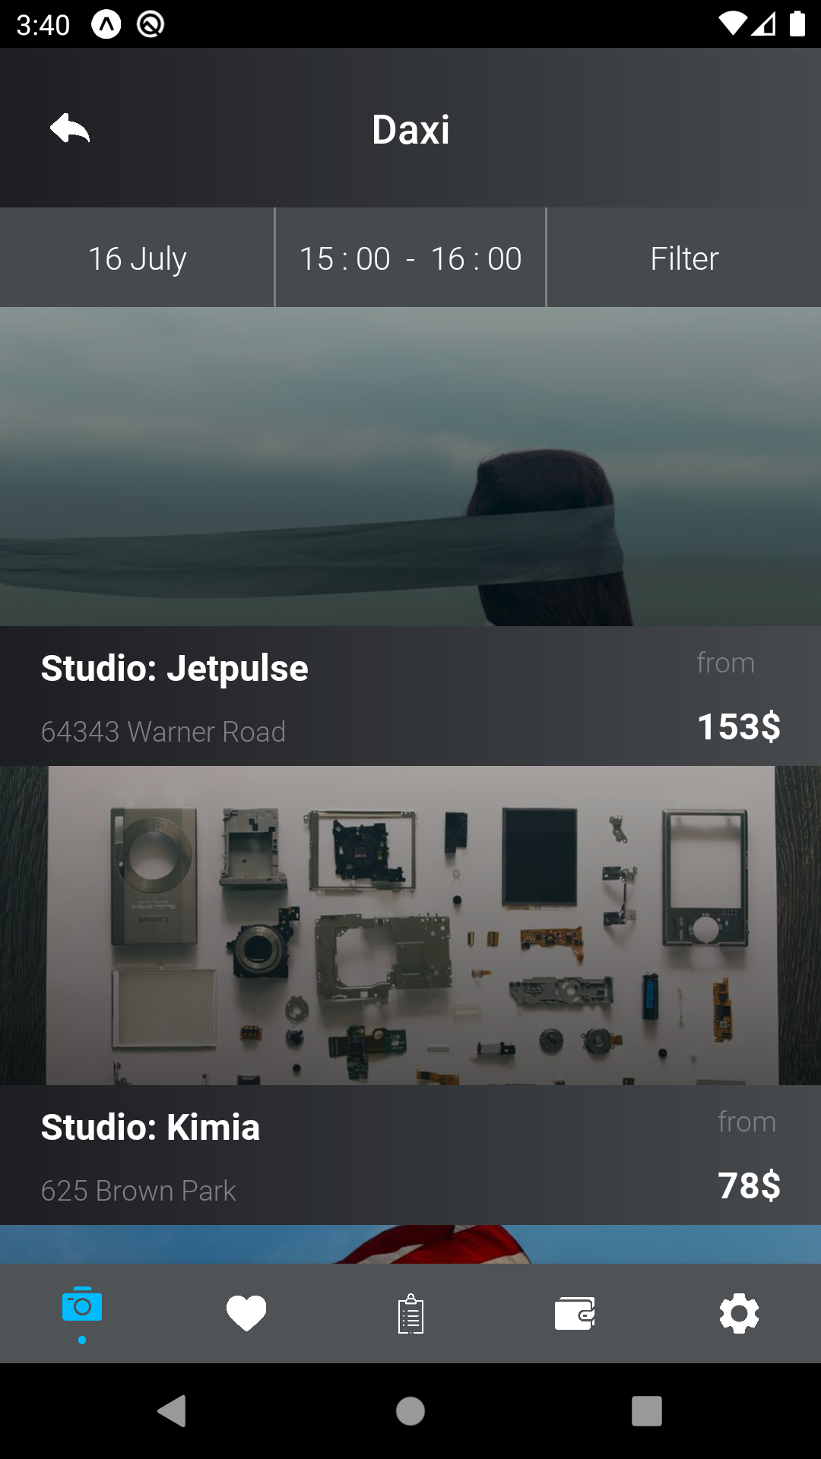
App screens

Slide 10
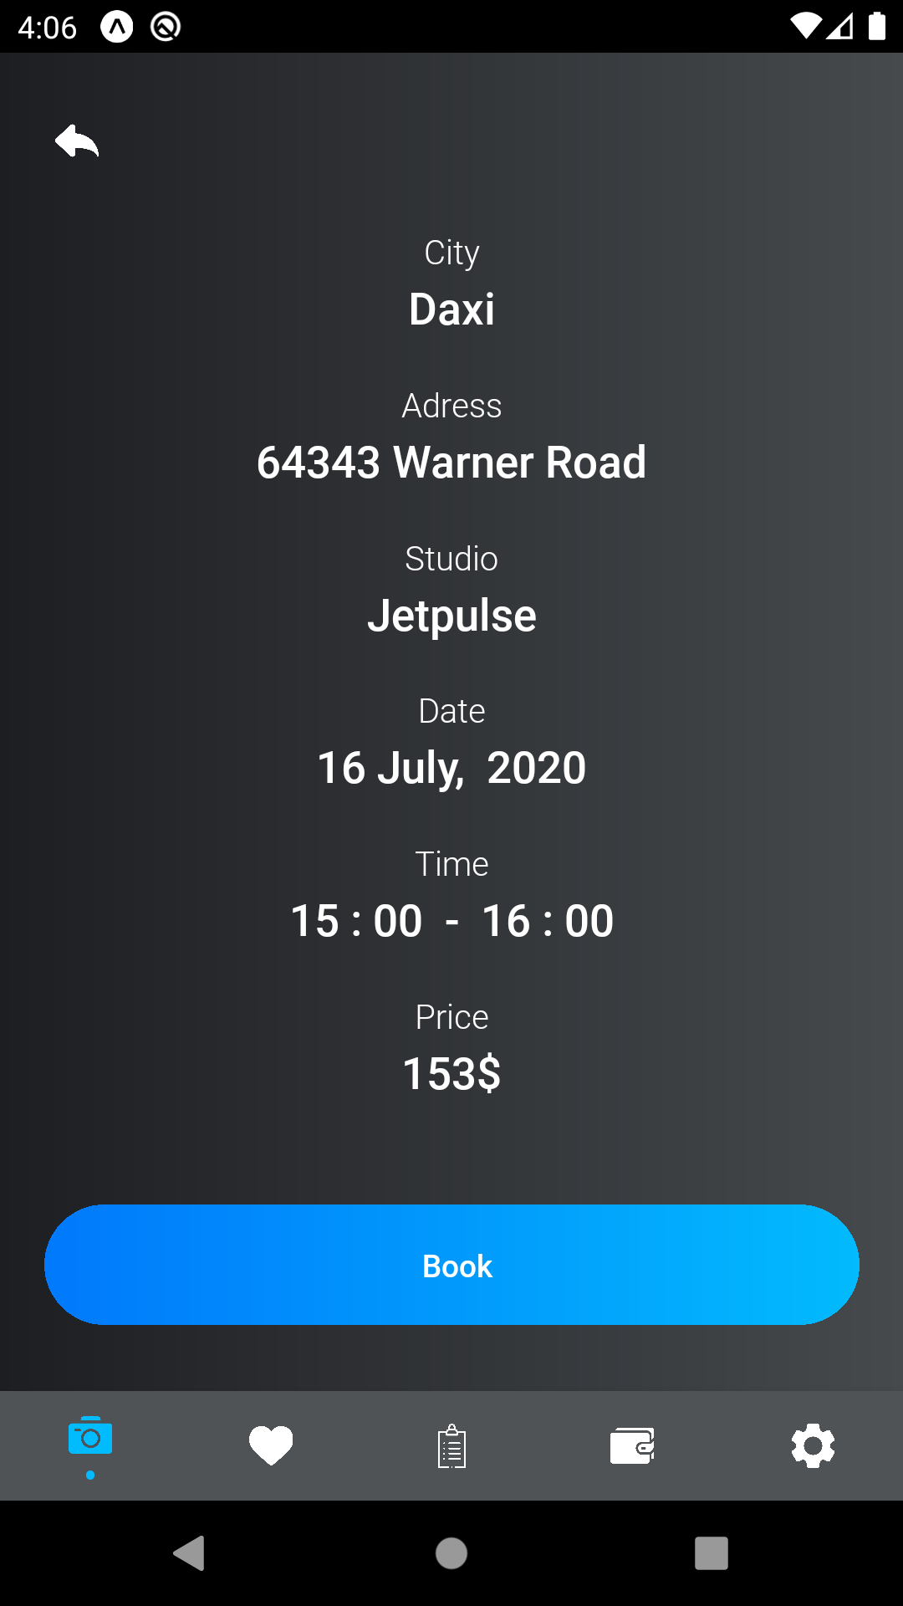
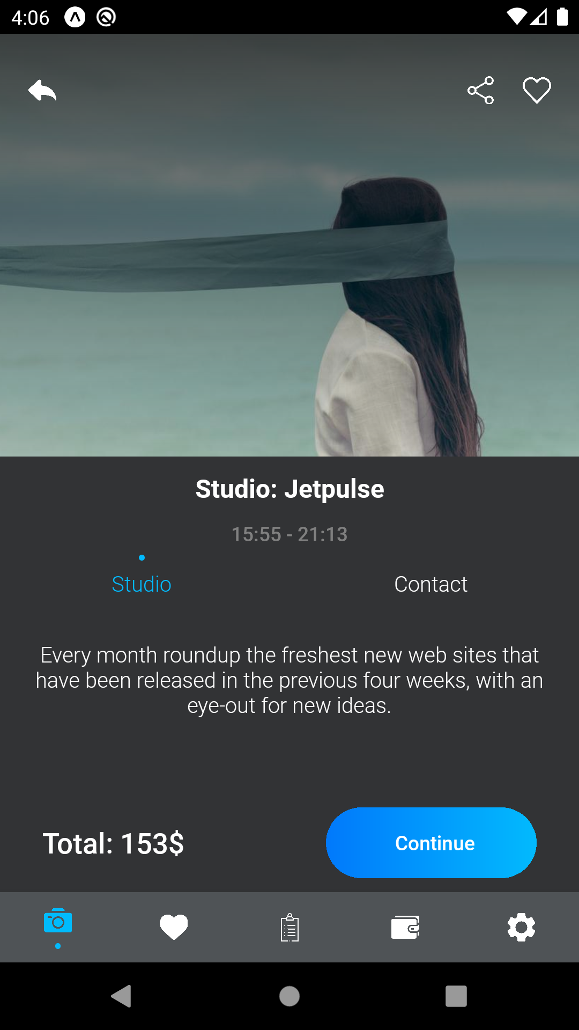

Slide 11
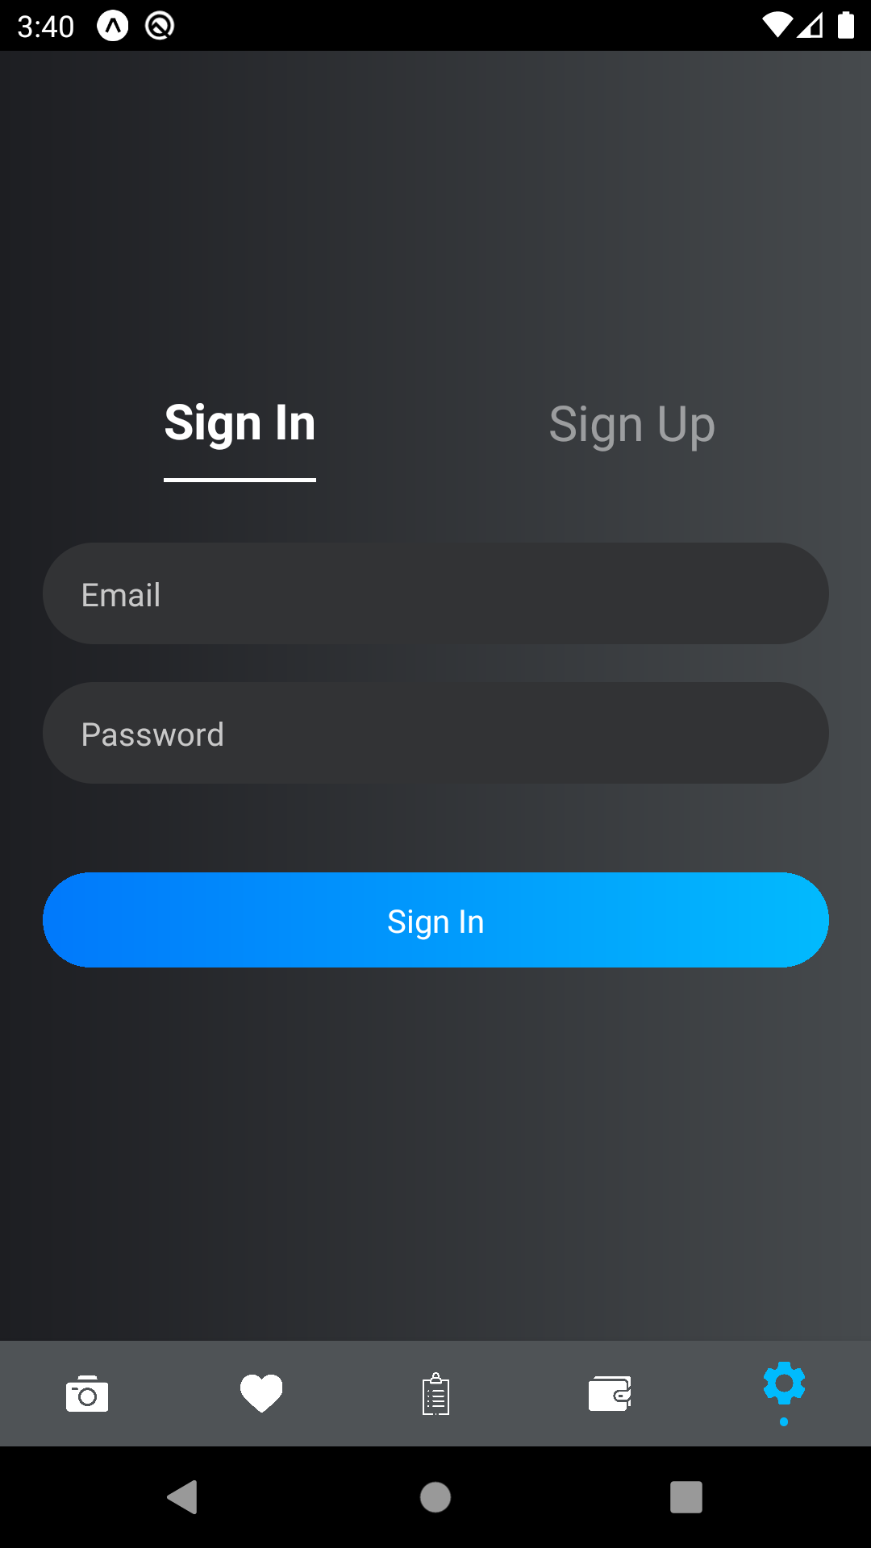
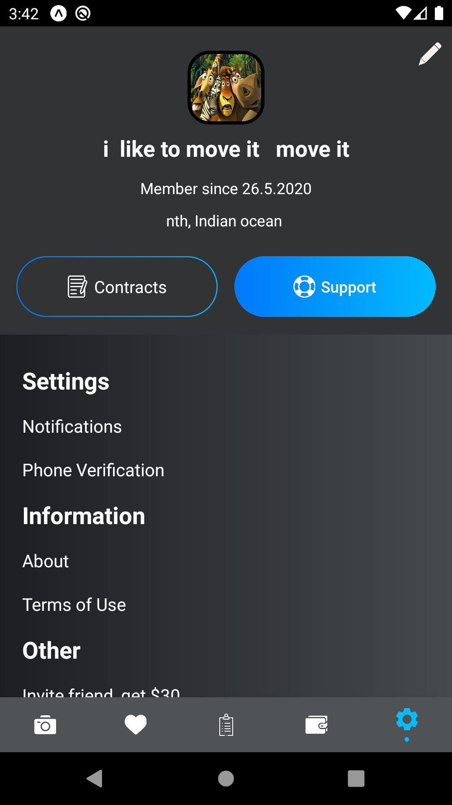
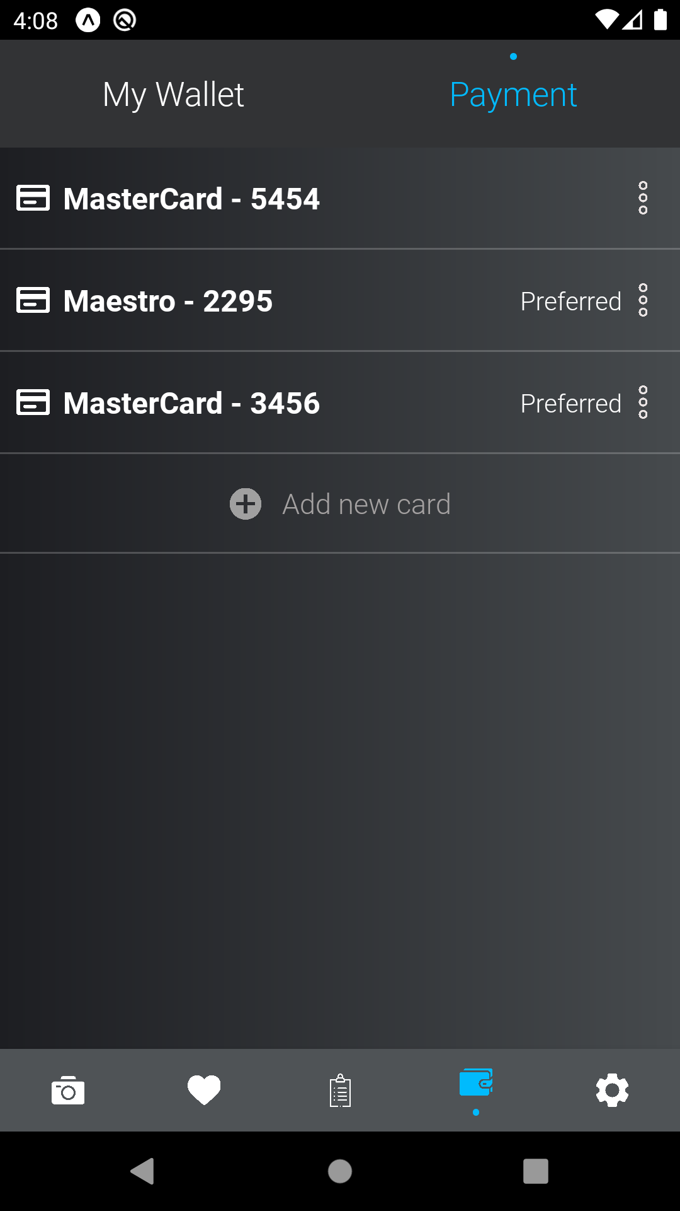

Slide 12
THANK
YOU
Notes:
<a href="https://www.freepik.com/free-photos-vectors/business">Business vector created by freepik - www.freepik.com</a>

